Slide 1

Core Knowledge of Geometry in an Amazonian Indigene Group
by Stanislas Dehaene, Véronique Izard, Pierre Pica, and Elizabeth Spelke
Science
Volume 311(5759):381-384
January 20, 2006
American Association for the Advancement of Science

Slide 2
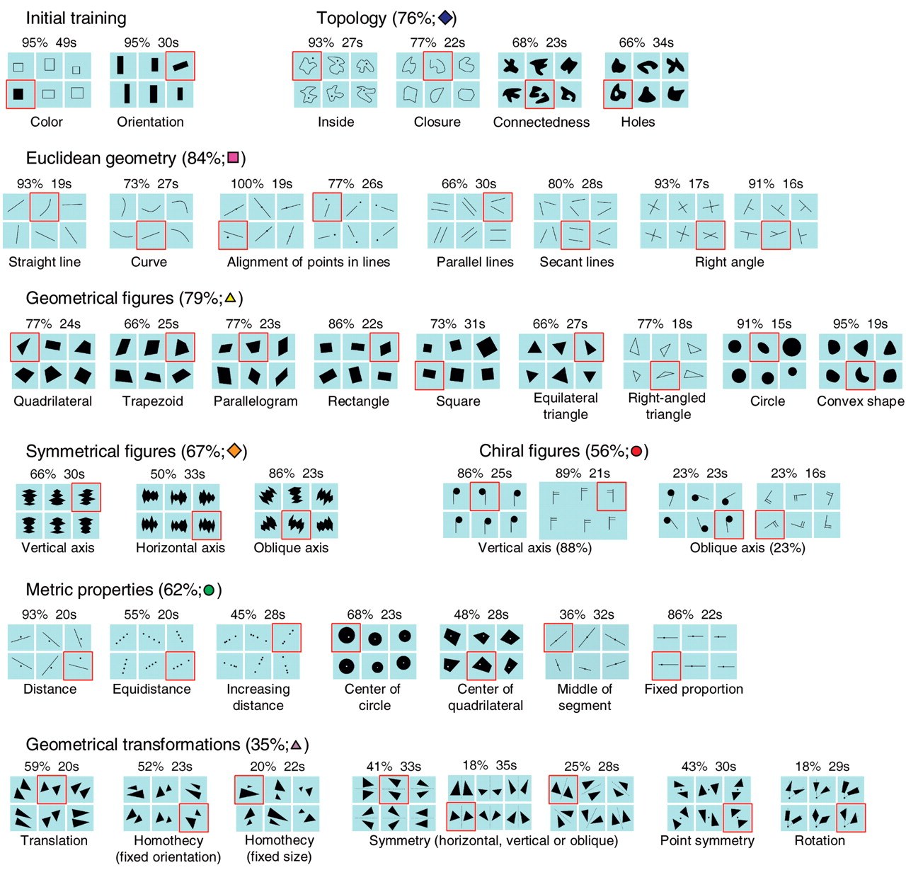
Fig. 1. Performance of Mundurukú participants in a multiple-choice test of the core concepts of geometry, rearranged in hierarchical order.
Stanislas Dehaene et al. Science 2006;311:381-384
American Association for the Advancement of Science
Notes:
Performance of Mundurukú participants in a multiple-choice test of the core concepts of geometry, rearranged in hierarchical order. In each slide, five images instantiate a specific concept indicated below, whereas the sixth (surrounded in red) violates it. The percentage of participants choosing the correct intruder is shown on top of each slide. Chance level is 16.6% correct; 28% correct corresponds to P < 0.05, and 35% correct to P < 0.001. Mean response times (in seconds) are also indicated. For each category of concept, the averaged percentage of correct answers is shown along with a color symbol used to refer to individual test items in Fig. 3.

Slide 3
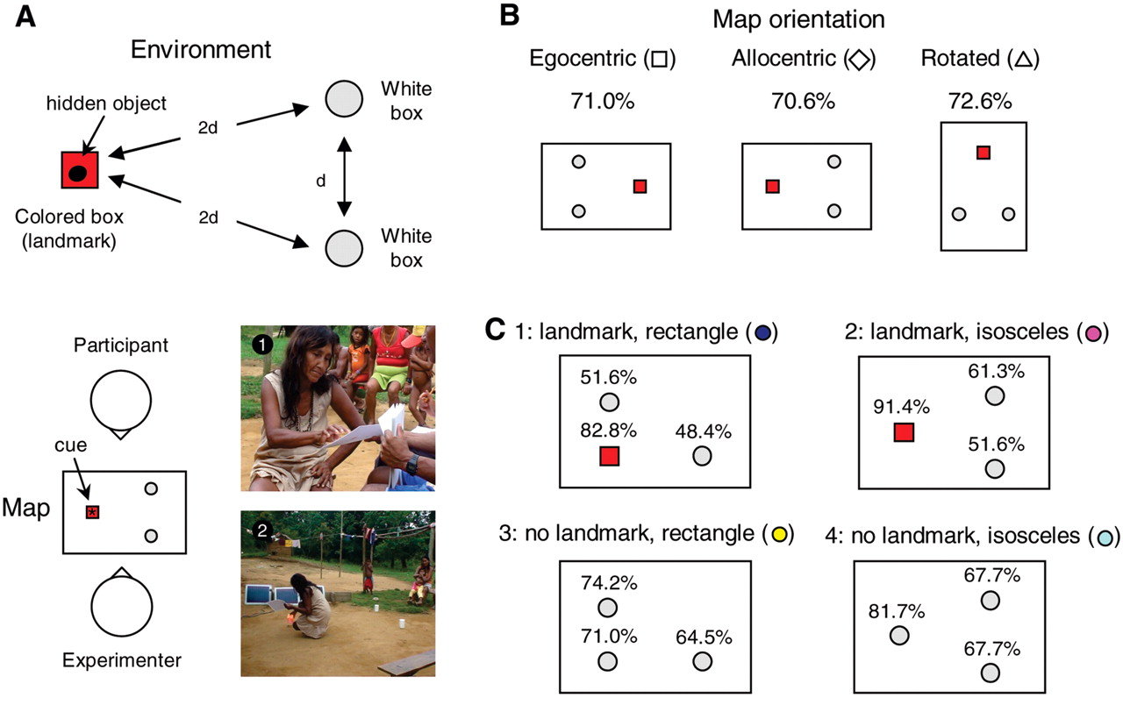
Fig. 2. Performance of Mundurukú participants in the map test.
Stanislas Dehaene et al. Science 2006;311:381-384
American Association for the Advancement of Science
Notes:
Performance of Mundurukú participants in the map test. (A) Schematic representation of the spatial layout of the experiment. On each trial, the participant was shown a “map” representing the location of three boxes, one of which contained a cue symbolizing a hidden object. Then he or she turned around and searched for the hidden object (distance d ≈ 1.5 m). (B) Performance in the three map orientations. The map and the environment could be aligned as seen from the top (allocentric condition), aligned relative to the participant before and after turning (egocentric condition), or nonaligned (90° rotation condition). (C) Performance at each location in the four successive blocks of the experiment. The symbols in (B) and the colors in (C) are used to refer to individual test items in Fig. 3.

Slide 4
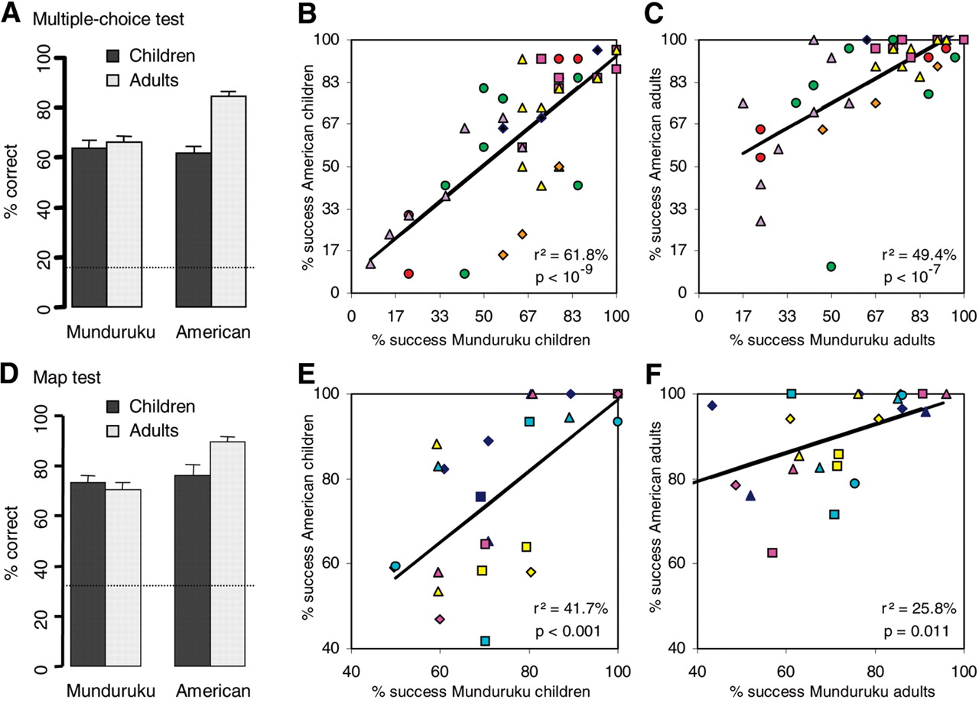
Fig. 3. Comparison of the geometrical performance of Mundurukú and American participants.
Stanislas Dehaene et al. Science 2006;311:381-384
American Association for the Advancement of Science
Notes:
Comparison of the geometrical performance of Mundurukú and American participants. (A to C) Multiple-choice test; (D to F) map test. (A) and (D) show the percent success averaged across participants and test items, as a function of age and culture (horizontal line = chance level; vertical bar = standard error). (B), (C), (E), and (F) show the correlation of performance level across test items, separately for children and adults. Each symbol represents average performance in response to a given test item. In (B) and (C), the symbol shapes and colors refer to the categories of slides defined in Fig. 1. In (E) and (F), symbol shapes refer to map orientation and color to map layout, as defined in Fig. 2. In both cases, r² and P values indicate the significance of the observed linear correlation in performance across the two cultures.

